Slide 1

Cyber Security
​
🔒 Protect Yourself from Online Scams
Presented by: Dhruthi N
Phishing awareness training
30-08-2025

Slide 2
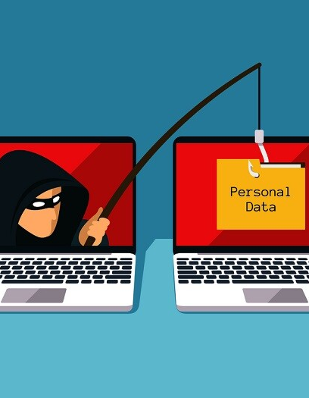
Phishing Awareness Training
​

Slide 3
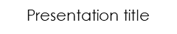
Agenda
1
2
3
4
5
Introduction to Phishing
Types of Phishing Attacks
Recognizing Phishing Emails
Recognizing Fake Websites
Social Engineering Tactics Used

Slide 4

Agenda
6
7
8
9
4
Best Practices & Tips to Stay Safe
Real-World Examples of Phishing
Interactive Quiz (Sample)
Conclusion

Slide 5
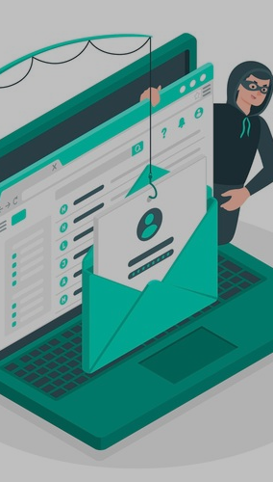
Introduction to Phishing
Definition: Phishing is a cybercrime where attackers disguise themselves as trustworthy entities to trick victims into revealing personal information such as usernames, passwords, or financial details.
Impact: Causes financial loss, leads to identity theft, can compromise organizations security.
Why It Matters: Over 90% of cyberattacks begin with a phishing email.

Slide 6
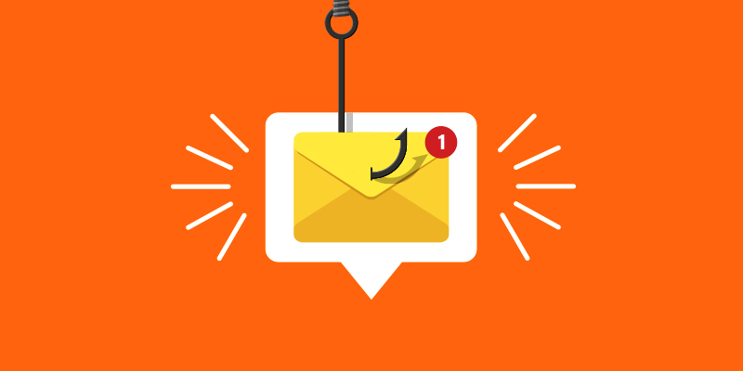
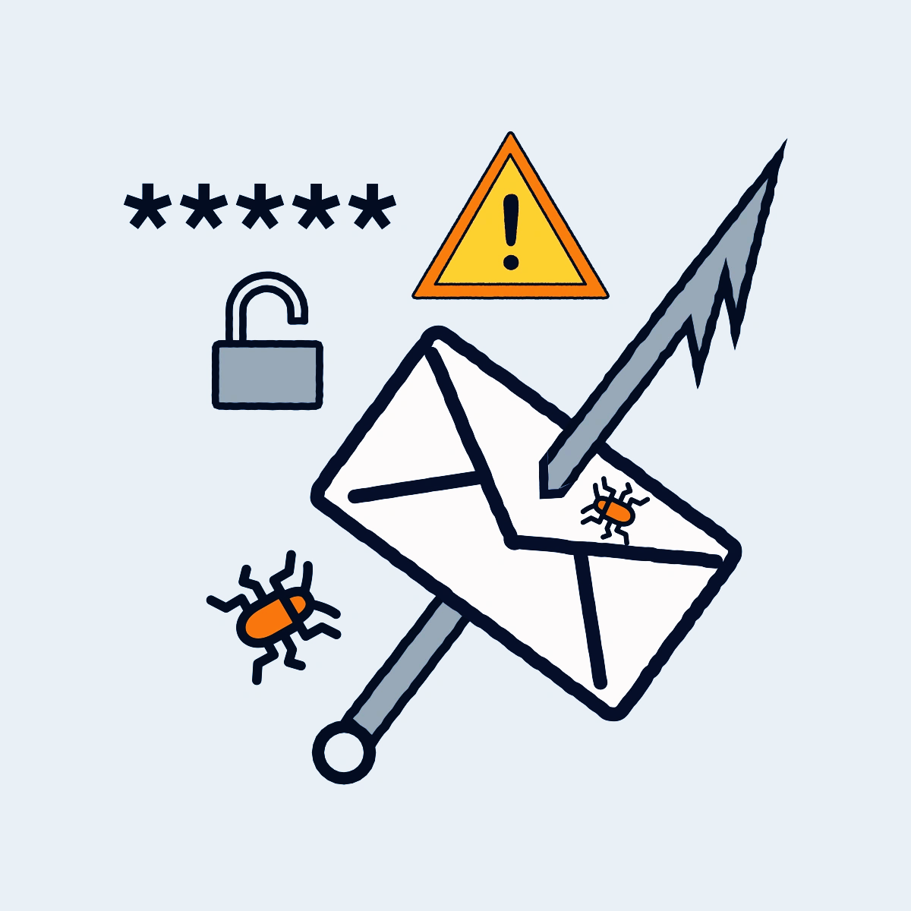
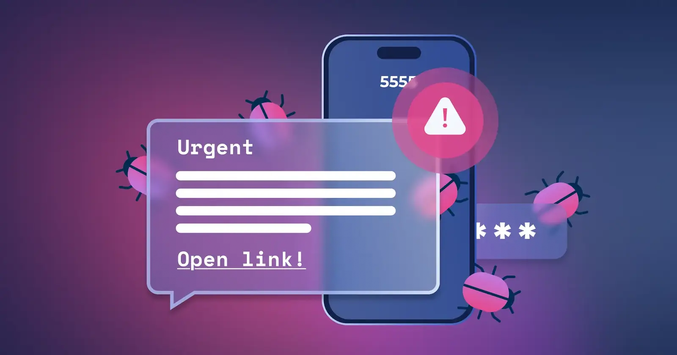
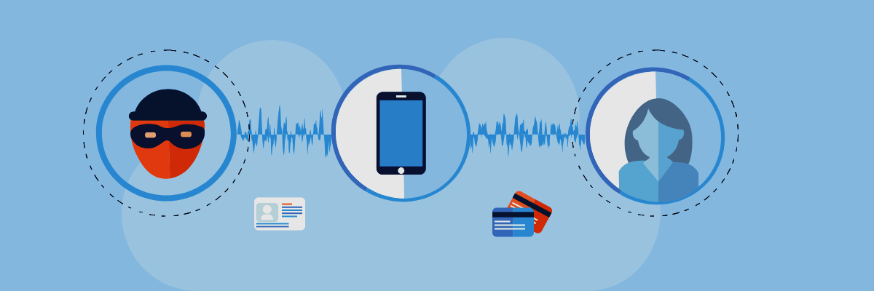
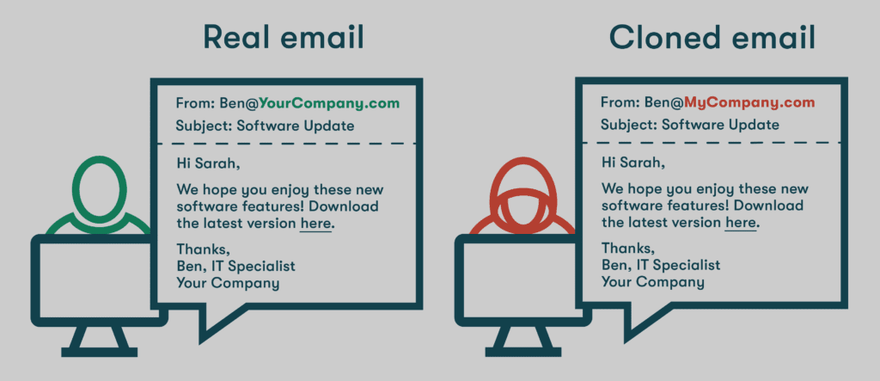
Types of Phishing Attacks
Email Phishing:
Fake emails imitating companies/banks. Most common phishing type
Spear Phishing:
Targeted at a specific person or organization. Uses personal details to appear genuine.
Smishing:
Phishing via SMS messages.
Example: “Your bank account is locked, click here to verify.”
Vishing (Voice Phishing):
Fraudulent phone calls asking for sensitive info.
Example: “We are calling from your bank’s fraud department.”
Clone Phishing:
An attacker copies a legitimate email, but replaces links with malicious ones.

Slide 7
Recognizing Phishing Emails
Key Warning Signs:
Suspicious Sender Address
Example: “support@paypa1.com” (note the ‘1’ instead of ‘l’).
Generic Greetings
“Dear Customer” instead of your real name.
Poor Spelling/Grammar
Often rushed or translated.
Urgent or Threatening Language
“Your account will be deactivated in 24 hours.”
Links and Attachments
Malicious links disguised as trusted websites.
Attachments may contain malware.

Slide 8
Recognizing Fake Websites
How to Spot Them:
Check URL carefully:
Real: www.paypal.com
Fake: www.paypa1securelogin.com
HTTPS Lock Icon:
Missing 🔒 symbol means unsafe.
Design Flaws:
Blurry logos, misaligned text, odd colors.
Login Prompts:
Fake sites ask directly for passwords or banking
info.

Slide 9
Social Engineering Tactics Used
Attackers exploit human psychology:
Authority – Pretending to be boss, bank, or government.
Fear & Urgency – “Pay your bill NOW to avoid penalty.”
Greed – “You’ve won a 1000 rupees gift card!”
Curiosity – “Check out this leaked video!”
Trust Exploitation – Using info from social media to appear legitimate

Slide 10
Best Practices & Tips to Stay Safe
✅ Prevention Tips:
Always verify sender before opening emails.
Hover over links to preview real URL.
Never download attachments from unknown sources.
Use strong, unique passwords + multi-factor authentication (MFA).Update antivirus and security patches regularly.
Enable spam filters in email.
Report phishing attempts to IT/security team.

Slide 11
Real-World Examples of Phishing​
📌 Example 1: Fake Bank Email
Subject: “Urgent! Your account is locked.”
Fake link provided to steal credentials.
📌 Example 2: Amazon Delivery Scam
SMS: “Your package cannot be delivered. Verify here: [fake link].”
📌 Example 3: Government/Tax Scam
Email: “You are eligible for a tax refund. Fill in your details.”

Slide 12
Interactive Quiz ​
Q1. Which of these is a red flag in an email?
Correct company logo
b) Urgent password reset request
c) Personalized name greeting
d) Secure HTTPS link
Q2. What should you check first before clicking a link?
The sender’s profile picture
The URL/domain)
The email’s font color
Q3. Which of the following is not a phishing tactic?
Urgency
b) Authority
c) Random curiosity
d) Data encryption

Slide 13
Answers
Q1.👉 Answer: b) Urgent password reset request
Q2. 👉 Answer:
b) The URL/domain
Q3.👉 Answer: d) Data encryption

Slide 14

Conclusion
Phishing attacks are the most common cybercrime but can be avoided with awareness.
Always stay alert, question suspicious messages, and “Think Before You Click.”
Protecting yourself means protecting your data, money, and your organization.

Slide 15

Thank you
dhruthin72@gmail.com

